Slide 1
JavaScript-1

Slide 2
Why JavaScript…?
Client side web development
Native JavaScript
JQuery
Angular, React
Server side development
NodeJS
Express
Browser Extensions
Desktop Applications
Mobile Applications
IOT Applications

Slide 3
Agenda
Introduction
Data types, Variables, Scope
Control Flow and Error Handling
Functions
Events

Slide 4
What is JavaScript…?
JavaScript (JS) is a lightweight, interpreted or JIT compiled programming language with first-class functions. Most well-known as the scripting language for Web pages, many non-browser environments also use it, such as node.js and Apache CouchDB. JS is a prototype-based, dynamic scripting language, supporting object-oriented styles.

Slide 5
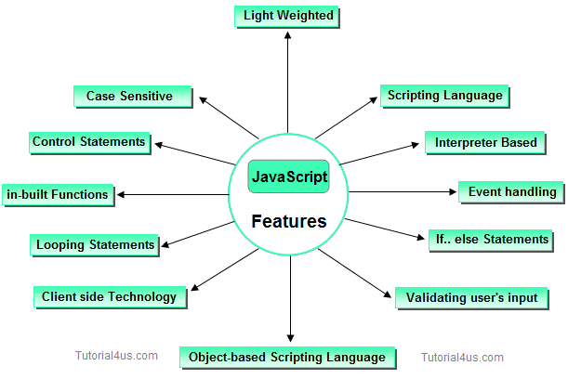
Features:

Slide 6
How it works…?
request
Browser
Server
HTML

Slide 7
Some JS Engines….
JS Engine is a program or an interpreter which executes javascript code.
Chrome V8, in C++
Firefox Spider Monkey, in C++
Safari JavascriptCore, by Apple
Edge Chakra, in C++

Slide 8
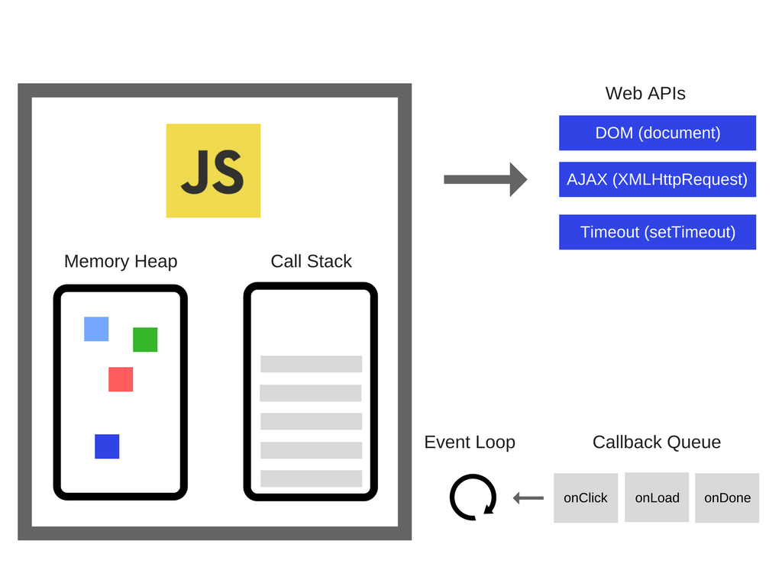
V8 Engine Architecture...
V8 translates JS code into more efficient machine code.

Slide 9
What is ECMA…?
European Computer Manufacturers Association.
JS Language Spec / implementation.
Standardizes the language.
Promotes Smooth execution.

Slide 10
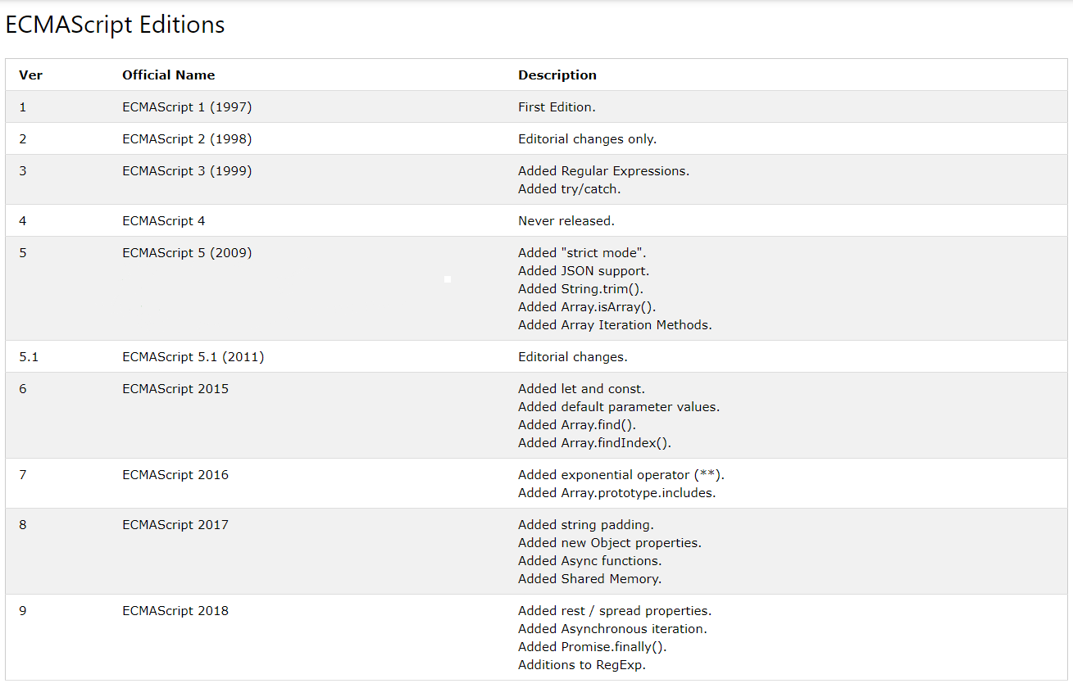

Slide 11
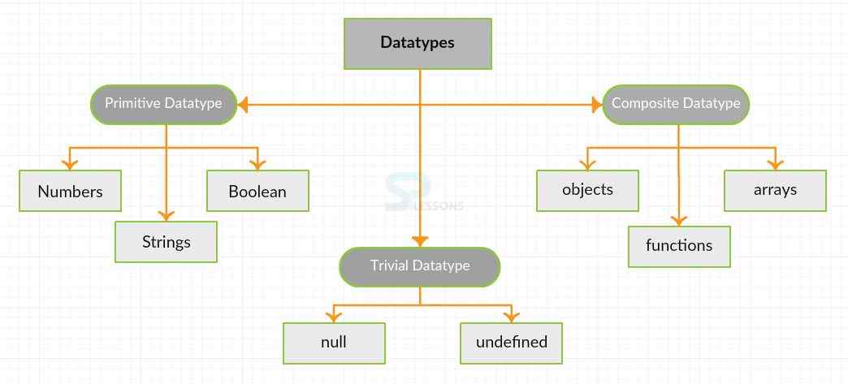
Data Types
NaN: Numeric Trivial data type.
Notes:
Primitive:immutable String str= "abc";//a object of string is created str = str + "def";// a new object of string is created and assigned to str

Slide 12
Variables:
Must declared by using keywords “var”,”let”,”const” in “Strict mode”.
Var x=5; let t=4; const n=42;
“let” creates a new block scope ({ }) for variable.
Scope of a “var” variable is either the function in which it is declared (function scope) or the global scope if it's declared outside any function.
Variables which are declared without using any keywords are considered as Global variables.
x=5;
Scope:
Local scope(Function scope)
Global scope
Lexical scope
Notes:
“Use strict”;a=1; --include “use strict” to enable strict mode

Slide 13
Type Coercion:
When the operands of an operator are different types, one of them will be converted to an "equivalent" value of the other operand's type.
Eg: 5+ true, “hello”+3, []+5, null+1, null+”1”, undefined+”1”,1==true,
Hoisting:
console.log(x);
var x=10;
console.log(x);
Javascript moves all declarations to the top. We can use variables in our code before declaring.
var x;
console.log(x);
x=10;
console.log(x);

Slide 14
var in function scope
function example() {
if (true) {
var x = 10;
console.log(x); // Output: 10
}
console.log(x); // Output: 10
}
example();

Slide 15
let in block scope
function example() {
if (true) {
let y = 20;
console.log(y); // Output: 20
}
console.log(y); // ReferenceError: y is not defined
}
example();

Slide 16
Questions:
for(var i=0;i<4;i++)
{
//statements..
}
console.log(i); ??
for(let i=0;i<4;i++)
{
// statements...
}
console.log(i); ??
Ans: 4
Reference Error: i is not defined.
var v="var";
let l="let";
console.log(this.v); ?
console.log(this.l); ?
var x=5;
function fun()
{
var x=10;
console.log(x); ??
}
console.log(x); ??
Ans: var
Ans: 10
Ans: undefined
Ans: 5

Slide 17
Lexical scope:
var outerFunction = function(){ var x = 5;
var nestedFunction = function() { var y = 7; console.log(x);
console.log(y); } return nestedFunction; } var myFunction = outerFunction(); myFunction();
console.log(y) ??
Referenced error: y is not defined
Ans: 5
Ans: 7

Slide 18
JS Objects (Different ways of using):
Record- set of properties
var myRecord = {firstName:"Tom", lastName:"Smith", age:26}
Map- like Associative arrays, Hash maps, Dictionary (key-value pairs)
var numeral2number = {"one":"1", "two":"2", "three":"3"}
UnTyped object- Set of properties and functions
var person1 = { lastName: "Smith", getFullName: function () { return "Mr. "+ this.lastName; } };
Namespace- Set of UnTyped objects. Same as namespace in java.
var myApp = { model:{}, view:{}, ctrl:{} };
Typed object- instantiates a class.
var arr=new Uint8Array(2); arr[0]=8;arr[1]=2;
Notes:
Primitive type objects:
uint8, int8, float32, object, uint16, int16, float64, string, uint32, int32

Slide 19
Data Structures:
Array Lists- dynamic arrays.
Var array= [1,2,3,4];
Methods: push(),pop(),slice(),indexof()....
Records
Maps
Entity tables
“Special maps” where the values are entity records with a standard ID (or primary key) slot, such that the keys of the map are the standard IDs of these entity records.
Key | Value
006251587X | { isbn:"006251587X," title:"Weaving the Web", year:2000 }
0465026567 | { isbn:"0465026567," title:"Gödel, Escher, Bach", year:1999 }

Slide 20
Control Flow and error handling
Block Statement
Break
Continue
Empty
If else
Switch
Throw
Try catch
for..in
if(Condition)
{
}
else
{
}
try{
statement;
}
catch(e)
{
statement;
}
switch(expression)
{
case case1:
stmt;
break;
.
.
}
Throw expression;
while (Condition) { if (Condition) { break; } statement; }
while(Condition);
Statement;
if(Condition);
statement;
{ statement;
}
for (var property1 in object1) {
string1 = string1 + object1[property1];
}
while (Condition) { statement; if (Condition) { continue; } statement; }
Notes:
Supported loops structure: For, while, do..while, forEach, for..in

Slide 21
Types Of Functions:
Function declaration
Function expression
Named Function expression
Function constructor
IIFE
Arrow Functions
Notes:
8 types, applications of different types

Slide 22
Function Declaration
Reusable Block of code
function function_name(paramtr_list)
{
Stmt;
……….
return result;
}
function square(number)
{ return number * number; }
square(10);

Slide 23
Question
function officer () {
return rank() + " Reginald Thistleton";
function rank () { return "Captain"; }
}
officer()

Slide 24
Function Expression
var square = function(number) {
return number * number;
}; var x = square(4);

Slide 25
Question
function officer () {
return rank() + " " + given() + " Thistleton";
var given = function () { return "Reginald"; };
function rank () { return "Captain"; }
}
officer()

Slide 26
Named Function Expression
var factorial = function computeFactorial(number) {
if (number <= 1)
{
return 1;
}
return number * computeFactorial(number - 1);
}
var result = factorial(5);
document.write(result);
Note: The name of the function (i.e compute Factorial) is available only with in the same function. This syntax is useful for creating recursive functions. If you use compute Factorial() method outside of the function it raises 'computeFactorial' is undefined error.

Slide 27
Function Constructor
The Function constructor creates a new Function object. Calling the constructor directly can create functions dynamically
Eg: var sum = new Function('a', 'b', 'return a + b');
console.log(sum(2, 6));

Slide 28
Function constructor don’t inherit their current scope properly
ex:
function foo(){
var bar = 'blah';
var first = new Function('console.log(typeof bar)');
first(); // undefined
var second = function(){
console.log(typeof bar);
}
second(); // string
}
foo();

Slide 29
Function Hoisting
JavaScript moves all the function declarations to the top of the current scope. This is called function hoisting.
How you see
console.log(square(10));
function square(number)
{
return number*number;
}
How Browser see
function square(number)
{
return number*number;
}
console.log(square(10));

Slide 30
Question?
function fun()
{
console.log(“hello”);
}
fun();
Answer:-
hello
var fun=function()
{
console.log(“hello”);
}
fun();
Answer:-
hello
fun();
function fun()
{
console.log(“hello”);
}
Answer:-
hello
fun();
var fun=function()
{
console.log(“hello”);
}
Answer:-
fun is not a function

Slide 31
Questions
function fun()
{
function meth()
{
console.log(“first”);
}
meth();
function meth()
{
console.log(“second”);
}
}
fun();
function fun()
{
var meth=function()
{
console.log(“first”);
}
meth();
var meth=function()
{
console.log(“second”);
}
}
fun();
Ans:- second
Ans:- first

Slide 32
Scope:
function fun(){
var x=10;
console.log(x);
}
function double_fun(){
var y=20;
console.log(y);
}
function combo_fun(){
console.log(x+y);
}
fun();
double_fun();
combo_fun();
Ans:- 10
Ans:- 20
Uncaught ReferenceError: x is not defined

Slide 33
IIFE
Immediately-Invoked Function Expression
(function(){
Stmt;
……….
})();
(function(){
console.log("hello");
})();

Slide 34
cont….
An IIFE is an anonymous function that is created and then immediately invoked.
It's not called from anywhere else (hence why it's anonymous),
but runs just after being created.
Advantages of IIFE:
Do not create unnecessary global variables and functions
Functions and variables defined in IIFE do not conflict with
other functions & variables even if they have same name.
Organize JavaScript code.
Make JavaScript code maintainable.

Slide 35
Arrow Functions
An arrow function expression is a syntactically compact alternative to a regular function expression, although without its own bindings to the this, arguments keywords.
Ex: [1,2, 3].map(x => x * 2);
// [2, 4, 6]

Slide 36
const test = {
name: 'test object',
createFunction: function() {
return function() {
console.log(this.name);
console.log(arguments);
};
},
createArrowFunction: function() {
return () => {
console.log(this.name);
console.log(arguments);
};
}
};
const anon = test.createFunction('hello', 'world');
const arrow = test.createArrowFunction('hello', 'world');
anon();
undefined
{}
arrow();
test object
{ '0': 'hello', '1': 'world' }

Slide 37
Closure
A closure is an inner function that has access to the outer function’s variables in addition to it's own variables and global variables.
The inner function has access not only to the outer function’s variables, but also to the outer function’s parameters.
Eg: function addNumbers(firstNumber, secondNumber)
{
var returnValue = "Result is : ";
// This inner function has access to the outer function's variables & parameters
function add()
{
return returnValue + (firstNumber + secondNumber);
}
return add(); //return add
}
var result = addNumbers(10, 20);

Slide 38
Closures
function Name(firstName) {
var lastName = 'ggk';
function fullName(){
return firstName+" "+lastName
}
return fullName;
}
var nm = Name("FN");
nm(); function fullName(firstName){
return firstName+" "+lastName
}
function Name(firstName) {
var lastName = 'ggk';
fName = fullName(firstName);
return fName;
}
var nm = Name("FN");
nm();

Slide 39
Example
var gLogNumber, gIncreaseNumber, gSetNumber;
function setupSomeGlobals() {
// Local variable that ends up within closure
var num = 42;
// Store some references to functions as global variables
gLogNumber = function() { console.log(num); }
gIncreaseNumber = function() { num++; }
gSetNumber = function(x) { num = x; }
}
setupSomeGlobals();
gIncreaseNumber();
gLogNumber(); // 43
gSetNumber(5);
gLogNumber(); // 5
var oldLog = gLogNumber;
setupSomeGlobals();
gLogNumber(); // 42
oldLog() // 5

Slide 40
Closure as Setter and Getter
function meth(){
var val=0;
function set(x){
val=x;
}
function get(){
console.log(val);
}
return{
set,
get
}
}
var m=meth();
m.get();
m.set(12);
m.get();

Slide 41
Closure for protection
function fun(){
var val=0;
function private(){
val=10;
console.log("private ");
}
function public(){
console.log(val);
console.log("public");
}
private();
return public;
}
var f=fun();
f();
Notes:
https://jsfiddle.net/saikumar2742/ckdpdrjs/16/

Slide 42
Sample codes
var v = 1;
var f1 = function () {
console.log(v);
}
var f2 = function() {
var v = 2;
f1();
};
f2();
function outer() {
let a = 42;
function inner() {
a = 43;
}
inner();
console.log(a);
}
outer();
let a = 1;
const closure1 = function() {
console.log(a);
a = 2
}
a = 3;
const closure2 = function() {
console.log(a);
}
closure1();
closure2();

Slide 43
Functions in block?
foo(); // error var a = true; if (a) { function foo() { console.log( "a" ); } } else { function foo() { console.log( "b" ); } }

Slide 44
cont...
var f;
var a = true;
if (a) {
f = function foo() { console.log( "a" ); }
}
else {
f = function foo() { console.log( "b" ); }
}
f();

Slide 45
Events
Onchange An HTML element has been changed
Onclick The user clicks an HTML element
Onmouseover The user moves the mouse over an HTML element
Onmouseout The user moves the mouse away from an HTML element
Onkeydown The user pushes a keyboard key

Slide 46
Adding/Removing EventListeners
Available Functions
element.addEventListener(eventType,function,isCapture)
isCapture => true for captureEvent , false for bubbleEvent
element.removeEventListener(eventType,function)

Slide 47
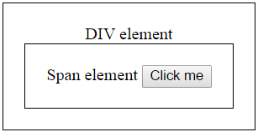
What is event bubbling :
Let us understand this with an example. HTML elements can be nested inside each other. For example a button element can be nested inside a span element and the span element in turn can be nested inside a div element as shown below.
Stopping event bubbling :
If you don't want the event to be bubbled up, you can stop it.
event.stopPropagation()
Notes:
https://jsfiddle.net/saikumar2742/g4w0tjdh/3/

Slide 48
What is event capturing :
Event capturing is the opposite of event bubbling.
--To enable event capturing we have set the third parameter (phase) of addEventListener() method to ‘true’.
--if it is set to ‘false’ event bubbling is enabled
Stopping event capturing :
If you don't want the event to be captured up, you can stop it.
event.stopPropagation()
Notes:
https://jsfiddle.net/saikumar2742/5o8k86w1/

Slide 49
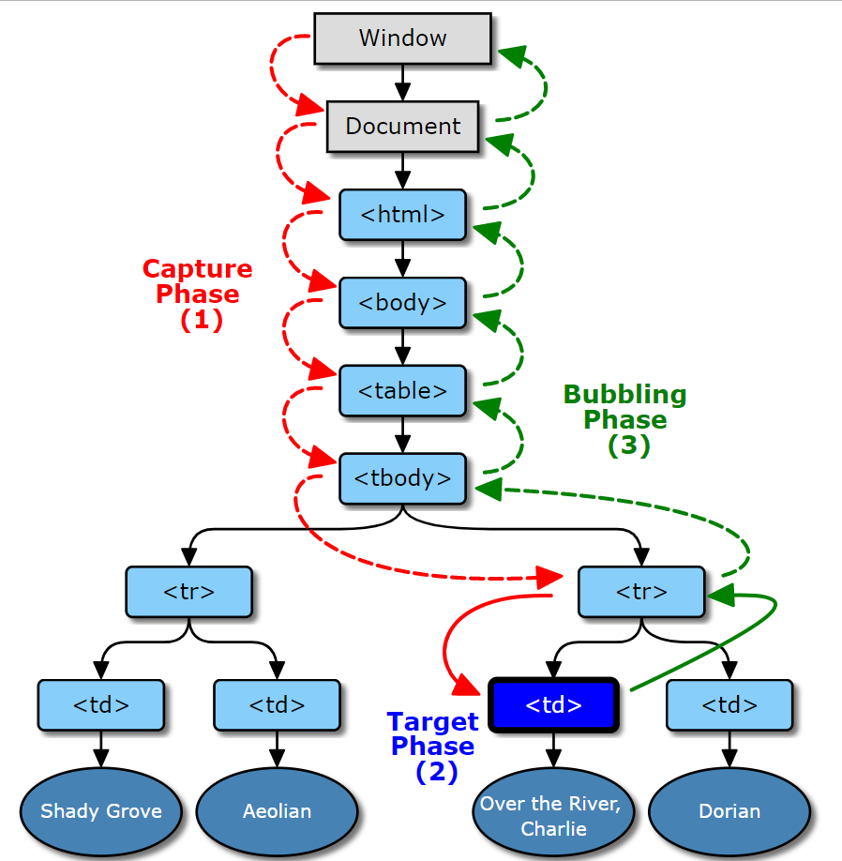
Event Propagation
Notes:
https://jsfiddle.net/xuvcw4er/15/

Slide 50
Sources:
https://stackoverflow.com/questions/111102/how-do-javascript-closures-work
https://www.davidbcalhoun.com/2011/different-ways-of-defining-functions-in-javascript-this-is-madness/
https://stackoverflow.com/questions/15336347/why-use-named-function-expressions
https://stackoverflow.com/questions/31671887/using-typeof-vs-to-check-undeclared-variable-produces-different-result

